Slide 1
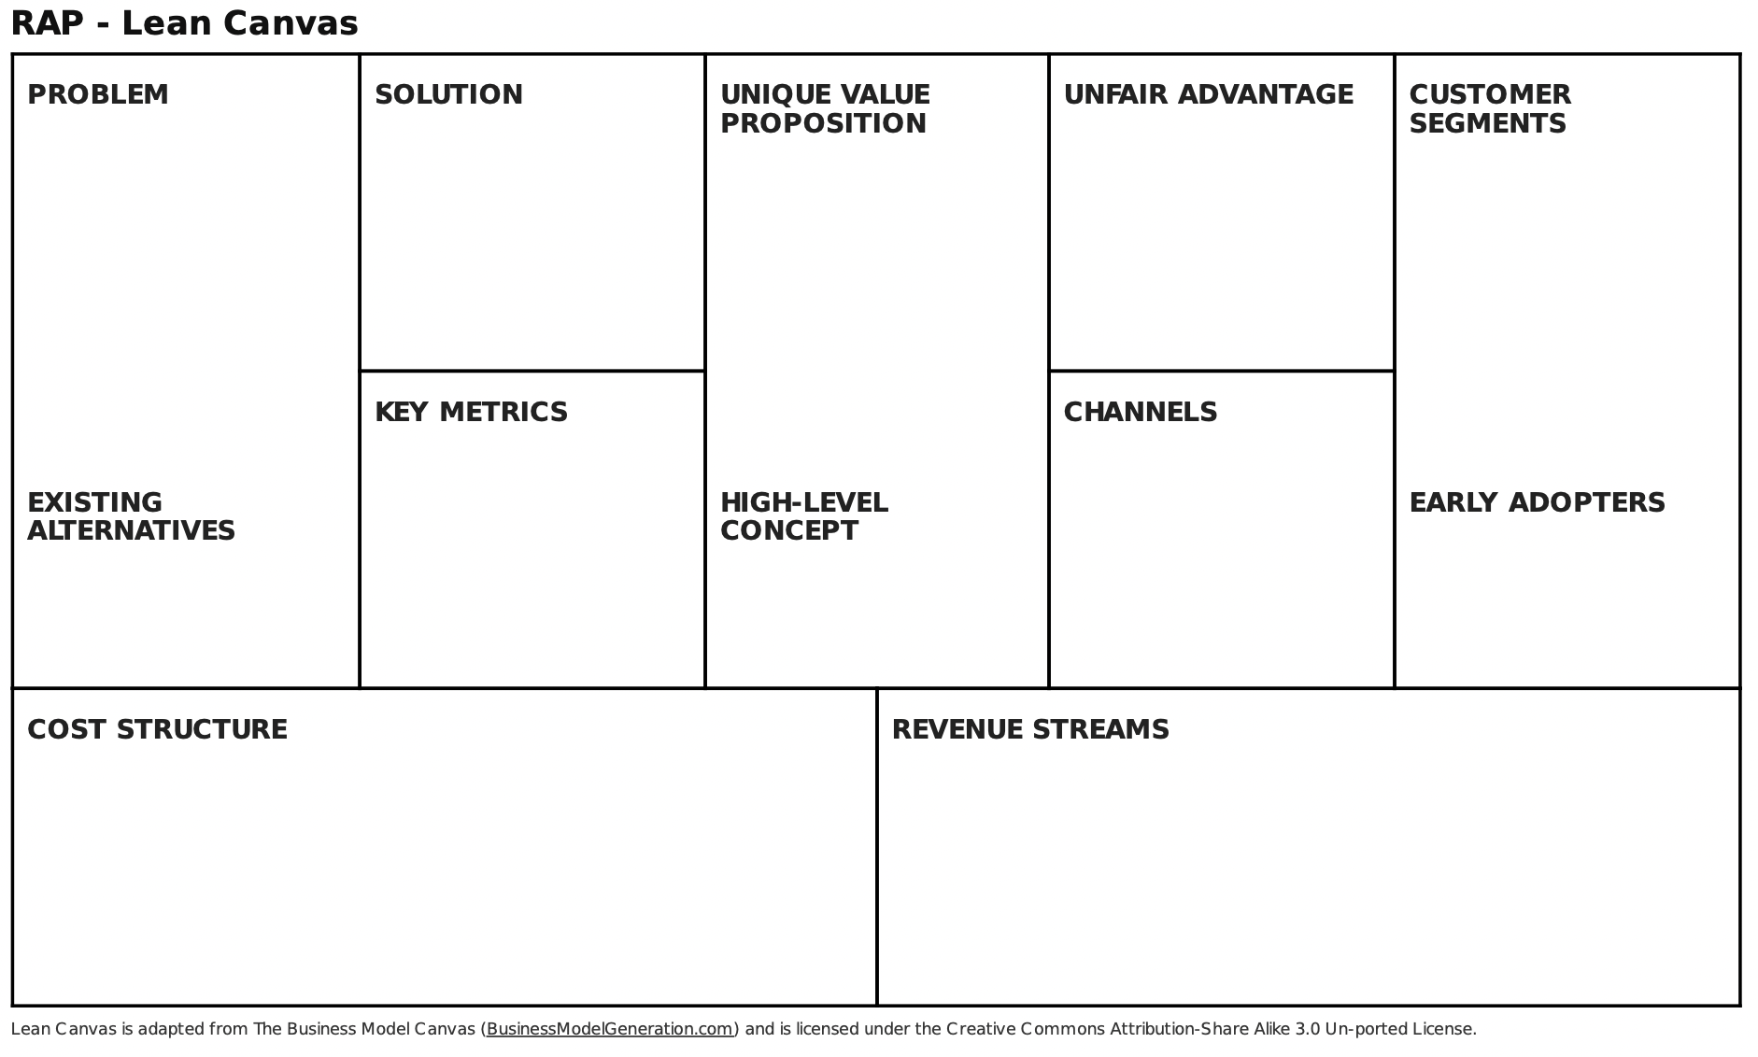
PROBLEM
SOLUTION
UNIQUE VALUE PROPOSITION
CHANNELS & OUTREACH STRATEGY
TARGET CUSTOMER
PROFILES
What problem do my customers need to solve?
What is my answer to their problem - my product or service?
What makes my offering different from anything on the market?
What are some specific customer types I serve?
(WHO PAYS)
How do I reach my customers?
OUTCOMES
STARTUP COSTS & REVENUE STREAMS
What is the ultimate outcome my customer gets from my offering?
How do I measure my business’s success?
What will it cost to operationalize my business and deliver my solution?
How do I make money?
MY VISION
MY 90-DAY PLAN
What outcome to I personally want out of this business venture? What does success look like in 1 year? 5 years?
Define my next steps – what do I need to operationalize my business? What unknowns do I need to answer? What is one thing I can experiment with?

Slide 2
PROBLEM
SOLUTION
UNIQUE VALUE PROPOSITION
CHANNELS & OUTREACH STRATEGY
TARGET CUSTOMER
PROFILES
OUTCOMES
STARTUP COSTS & REVENUE STREAMS
MY VISION
MY 90-DAY PLAN

Slide 3
PROBLEM
SOLUTION
UNIQUE VALUE PROPOSITION
CHANNELS & OUTREACH STRATEGY
TARGET CUSTOMER
PROFILES
What problem do my customers need to solve?
What is my answer to their problem - my product or service?
What makes my offering different from anything on the market?
What are some specific customer types I serve?
(WHO PAYS)
How do I reach my customers?
What problem have I observed in the market? Why does my business exist– what do my customers need?
What are their challenges?
What happens if they don’t solve this problem?
How have they tried to solve this problem?
OUTCOMES
CHANNELS
STARTUP COSTS & REVENUE STREAMS
What is the ultimate outcome my customer gets from my offering?
How do I measure my business’s success?
How do I reach my customers?
What will it cost to operationalize my business and deliver my solution?
How do I make money?
MY VISION
STARTUP COSTS & REVENUE STREAMS
MY 90-DAY PLAN
What outcome to I personally want out of this business venture? What does success look like in 1 year? 5 years?
Define my next steps – what do I need to operationalize my business? What unknowns do I need to answer? What is one thing I can experiment with?

Slide 4
PROBLEM
SOLUTION
UNIQUE VALUE PROPOSITION
CHANNELS & OUTREACH STRATEGY
TARGET CUSTOMER
PROFILES
What problem do my customers need to solve?
What is my answer to their problem - my product or service?
What is my ideal outcome?
When I imagine day-to-day work in my business, how do I spend my time?
What might my customer/revenue goals be in the next year?
What does success look like to me in 5 years?
What makes my offering different from anything on the market?
What are some specific customer types I serve?
(WHO PAYS)
How do I reach my customers?
OUTCOMES
STARTUP COSTS & REVENUE STREAMS
CHANNELS
What is the ultimate outcome my customer gets from my offering?
How do I measure my business’s success?
What will it cost to operationalize my business and deliver my solution?
How do I make money?
How do I reach my customers?
MY VISION
MY 90-DAY PLAN
What outcome to I personally want out of this business venture? What does success look like in 1 year? 5 years?
Define my next steps – what do I need to operationalize my business? What unknowns do I need to answer? What is one thing I can experiment with?

Slide 5
PROBLEM
SOLUTION
UNIQUE VALUE PROPOSITION
CHANNELS & OUTREACH STRATEGY
TARGET CUSTOMER
PROFILES
What problem do my customers need to solve?
What is my answer to their problem - my product or service?
What makes my offering different from anything on the market?
What are some specific customer types I serve?
(WHO PAYS)
Who is your ideal customer? Whose problem are you solving?
Get specific.
What pain points do they have?
What are their characteristics?
What does their day-to-day look like?
*Are there other important stakeholders? Will you have users who are not customers?
How do I reach my customers?
OUTCOMES
STARTUP COSTS & REVENUE STREAMS
What is the ultimate outcome my customer gets from my offering?
How do I measure my business’s success?
What will it cost to operationalize my business and deliver my solution?
How do I make money?
MY VISION
MY 90-DAY PLAN
What outcome to I personally want out of this business venture? What does success look like in 1 year? 5 years?
Define my next steps – what do I need to operationalize my business? What unknowns do I need to answer? What is one thing I can experiment with?

Slide 6
PROBLEM
SOLUTION
UNIQUE VALUE PROPOSITION
CHANNELS & OUTREACH STRATEGY
TARGET CUSTOMER
PROFILES
What problem do my customers need to solve?
What is my answer to their problem - my product or service?
What makes my offering different from anything on the market?
What are some specific customer types I serve?
(WHO PAYS)
What is necessary to establish your business and start operating? What does it cost to deliver your offering to any given customer?
What is your business model– what does your customer pay for?
How do I reach my customers?
OUTCOMES
STARTUP COSTS & REVENUE STREAMS
What is the ultimate outcome my customer gets from my offering?
How do I measure my business’s success?
What will it cost to operationalize my business and deliver my solution?
How do I make money?
MY VISION
MY 90-DAY PLAN
What outcome to I personally want out of this business venture? What does success look like in 1 year? 5 years?
Define my next steps – what do I need to operationalize my business? What unknowns do I need to answer? What is one thing I can experiment with?

Slide 7
PROBLEM
SOLUTION
UNIQUE VALUE PROPOSITION
CHANNELS & OUTREACH STRATEGY
TARGET CUSTOMER
PROFILES
What problem do my customers need to solve?
What is my answer to their problem - my product or service?
Where do your target customers congregate, online or in the real world? How do they engage with or access similar solutions? What partners might help you to connect with your customers? What marketing strategies work well for your audience?
What makes my offering different from anything on the market?
What are some specific customer types I serve?
(WHO PAYS)
How do I reach my customers?
OUTCOMES
STARTUP COSTS & REVENUE STREAMS
What is the ultimate outcome my customer gets from my offering?
How do I measure my business’s success?
What will it cost to operationalize my business and deliver my solution?
How do I make money?
MY VISION
MY 90-DAY PLAN
What outcome to I personally want out of this business venture? What does success look like in 1 year? 5 years?
Define my next steps – what do I need to operationalize my business? What unknowns do I need to answer? What is one thing I can experiment with?

Slide 8
PROBLEM
SOLUTION
UNIQUE VALUE PROPOSITION
CHANNELS & OUTREACH STRATEGY
TARGET CUSTOMER
PROFILES
What problem do my customers need to solve?
What is my answer to their problem - my product or service?
What makes my offering different from anything on the market?
What are some specific customer types I serve?
(WHO PAYS)
How do I reach my customers?
OUTCOMES
STARTUP COSTS & REVENUE STREAMS
What is the ultimate outcome my customer gets from my offering?
How do I measure my business’s success?
What will it cost to operationalize my business and deliver my solution?
How do I make money?
Why do your customers engage with your offering over any other alternative? What makes you stand out or sets you apart from your competition? What is the core value your customer gets from working with you?
MY VISION
MY 90-DAY PLAN
What outcome to I personally want out of this business venture? What does success look like in 1 year? 5 years?
Define my next steps – what do I need to operationalize my business? What unknowns do I need to answer? What is one thing I can experiment with?

Slide 9
PROBLEM
SOLUTION
UNIQUE VALUE PROPOSITION
CHANNELS & OUTREACH STRATEGY
TARGET CUSTOMER
PROFILES
What problem do my customers need to solve?
What is my answer to their problem - my product or service?
What makes my offering different from anything on the market?
What are some specific customer types I serve?
(WHO PAYS)
How do I reach my customers?
What is the final result that a customer gets from your offering (even psychological or emotional outcomes)? How can you measure that result? What other metrics are important for you to monitor the success of your business?
OUTCOMES
STARTUP COSTS & REVENUE STREAMS
What is the ultimate outcome my customer gets from my offering?
How do I measure my business’s success?
What will it cost to operationalize my business and deliver my solution?
How do I make money?
MY VISION
MY 90-DAY PLAN
What outcome to I personally want out of this business venture? What does success look like in 1 year? 5 years?
Define my next steps – what do I need to operationalize my business? What unknowns do I need to answer? What is one thing I can experiment with?

Slide 10
PROBLEM
SOLUTION
UNIQUE VALUE PROPOSITION
CHANNELS & OUTREACH STRATEGY
TARGET CUSTOMER
PROFILES
What aspects of my business do I need more clarity on? What activities can I implement to get the answers I need in a short amount of time? What barriers can I knock down in 3 months that will create more opportunity for my business to grow? What are my immediate priorities?
What problem do my customers need to solve?
What is my answer to their problem - my product or service?
What makes my offering different from anything on the market?
What are some specific customer types I serve?
(WHO PAYS)
How do I reach my customers?
OUTCOMES
STARTUP COSTS & REVENUE STREAMS
CHANNELS
What is the ultimate outcome my customer gets from my offering?
How do I measure my business’s success?
What will it cost to operationalize my business and deliver my solution?
How do I make money?
How do I reach my customers?
MY VISION
MY 90-DAY PLAN
What outcome to I personally want out of this business venture? What does success look like in 1 year? 5 years?
Define my next steps – what do I need to operationalize my business? What unknowns do I need to answer? What is one thing I can experiment with?

